Slide 1
Spring Boot
Add Static Pages

Slide 2
Content
Add static pages
Add favicon
Add project name to the url
Merge the email and the registerationandlogin projects

Slide 3
Add static pages to the email project Save a copy of your email project first
Spring Boot automatically add static resources placed inside any of the following folders or directories in your class path
classpath:/public/
classpath:/static/
classpath:/resources/
classpath:/META-INF/resources/
IT can be customized in the application.properties file, e.g.,
spring.resources.static-locations=classpath:/custom/,classpath:/static/

Slide 4
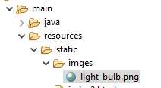
Favicon
<!DOCTYPE HTML>
<html xmlns:th="http://www.thymeleaf.org">
<head>
<meta http-equiv="Content-Type" content="text/html; charset=UTF-8" />
<title>Jianwei's IT353</title>
<link rel="shortcut icon" href="/imges/light-bulb.png“/>
</head>

Slide 5
Add project name to the url
In application.properties
server.servlet.context-path=/IT353

Slide 6
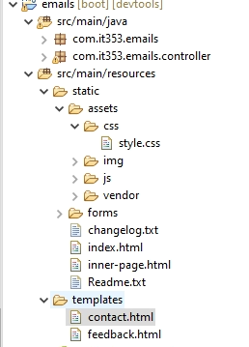
Refer to css file in the static folder
https://www.baeldung.com/spring-thymeleaf-css-js

Slide 7
Try it with url
localhost:8080/IT353/assets/css/style.css

Slide 8
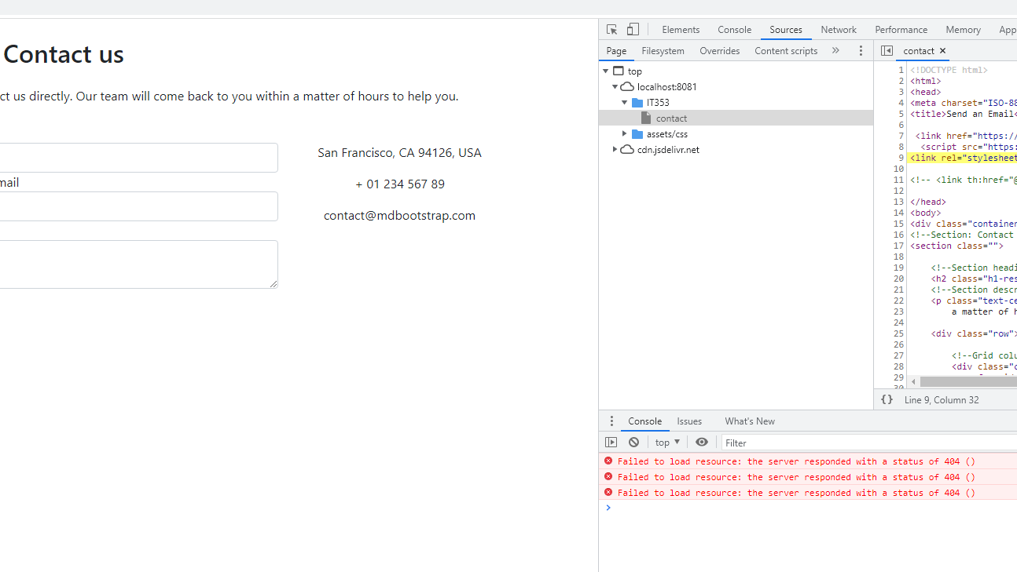
<link rel="stylesheet“ href="/assets/css/style.css“/>
Notes:
Remove /before assets

Slide 9
Use thymeleaf instead
<html xmlns:th="http://www.thymeleaf.org">
<link th:href="@{/assets/css/style.css}" rel="stylesheet" />

Slide 10
How to get JavaScript
<script th:inline="javascript"> var nameJs = /*[[${name}]]*/; </script>

Slide 11
How to add the favicon to the contact page?
Notes:
<link rel="shortcut icon" th:href="@{/assets/img/favicon.png}" />

Slide 12
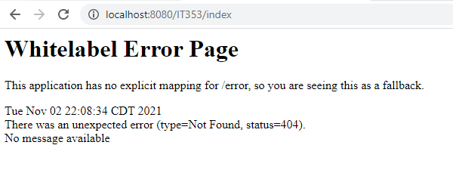
Why the index page does not exist?
@GetMapping("")
public String viewHomePage() {
return "index";
}
Notes:
It refers to the index page in the template folder, but we did not map to it
@GetMapping("")
public String viewHomePage() {
return "index";
}
Change to
@GetMapping({"", "/index"})

Slide 13
Compare return and return “redirect:”
return "signup_form";
return “redirect:/register";
Notes:
return “redirect:/index.html”; ---can be used to point to the index.html file in the static folder.

Slide 14
How to link to a static page from the templates folder?
Notes:
<h3><a th:href="@{/index.html}">index</a></h3>

Slide 15
How to link to a page in the templates folder from a static page?
Notes:
<li><a class="nav-link scrollto" href=“contact">Contact</a></li>
Do more add/before contact， otherwise, the context-path won’t add to the url automatically.

Slide 16
In-class practice 5: Save a copies of all projects first
Add you own final project static pages to your RegisterandLogin project
Merge your existing contact project (which is also your assignment 3 project) into the RegisterandLogin project
In the contact.html page, use thymleaf th:action="@{/contact}” for action in the form as follows. action=”contact” may give you a 403 error.
<form id="contact-form" name="contact-form" th:action="@{/contact}" method="POST" enctype="multipart/form-data">

Slide 17
In-class practice 5:
The goal of this practice is to make sure you know where you put static files, and how to connect between static pages and pages in the templates folder.
You need to merge the dependencies in the pom.xml file to make the functions from both projects work.
The code in application.properties should also be merged.

